Slide 1
Celebrating our unique strengths and differences
March 16 - 20, 2026

Slide 2


What is Neurodiversity Celebration Week About?
Neurodiversity Celebration Week is about celebrating the strengths and talents of people who think and learn differently.
It is also about recognising hard work and determination.
Neurodiversity Celebration Week is one way of reminding everyone of the importance of being kind and accepting of everyone.

Slide 3
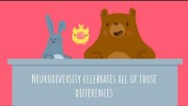
What is Neurodiversity?
Video credit: Dr Tamara Glen Soles, PhD

Slide 4
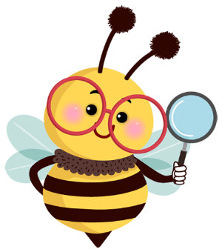
What are you good at?
Differences in the way our brains are wired means that you may find some things challenging that others find easy.
You may also find things easy that other people find challenging.
What are you really good at?
What do you find difficult?

Slide 5
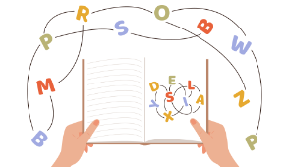
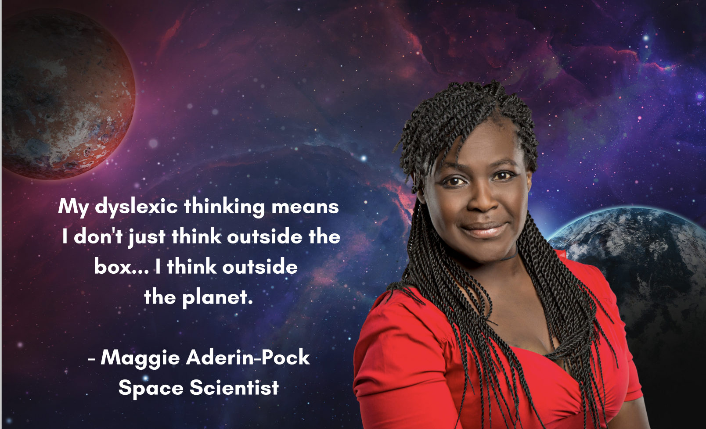


Dyslexia
Often great at talking, solving problems and
being creative
May find reading, writing and memory tricky
Maggie Aderin-Pocock, Space Scientist

Slide 6
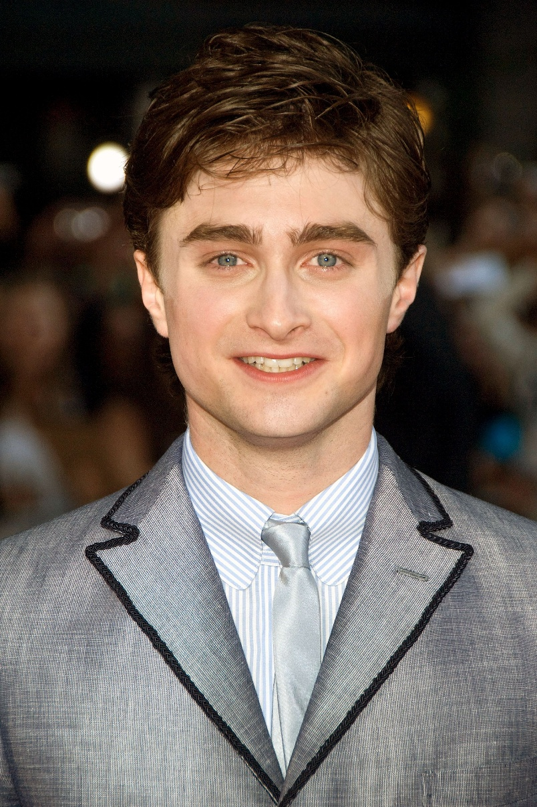

Dyspraxia
“Do not let it stop you. It has never held me back, and some of the smartest people I know are people who have learning disabilities.
The fact that some things are more of a struggle will only make you more determined, harder working and more imaginative in the solutions you find to problems.”
Often great at having original ideas, solving problems and
being determined
May find coordination and movement tricky
Daniel Radcliffe, Actor

Slide 7
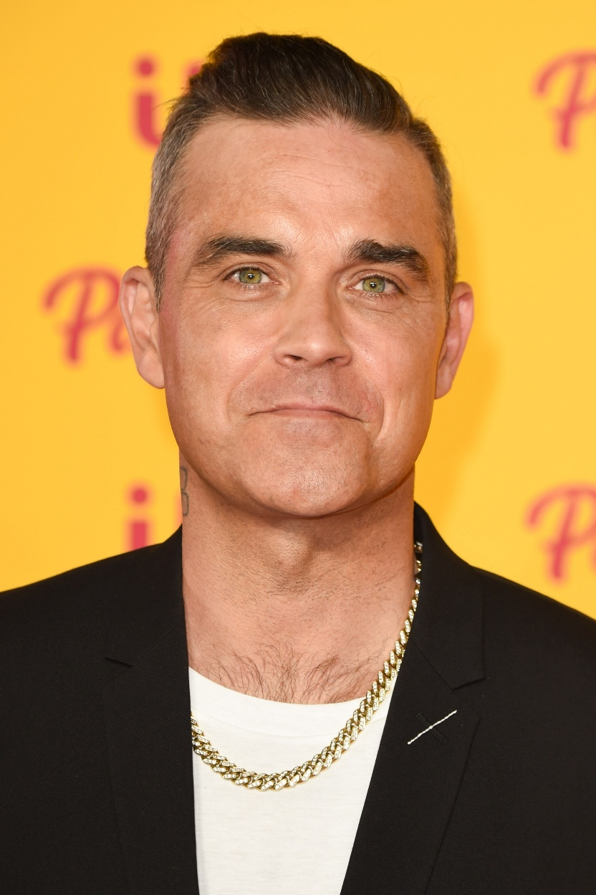
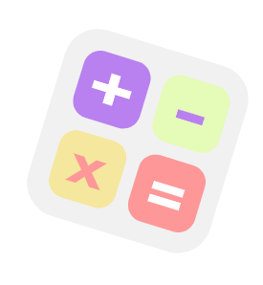
Dyscalculia
“You are astonishing, you just don’t know it yet.
I’m surrounded by incredibly successful people and most of them are like you and I.”
Often great at
solving problems and
thinking big thoughts
Robbie Williams, Singer
May find maths tricky

Slide 8
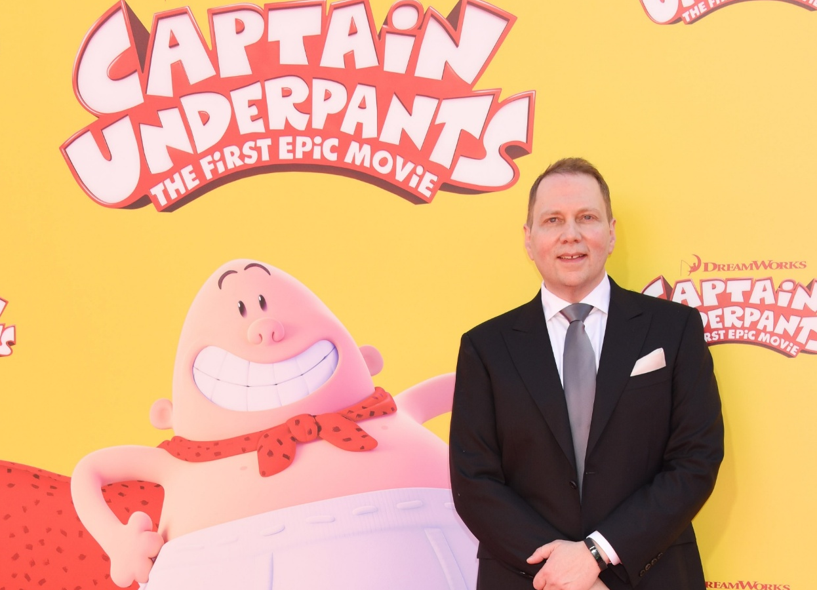
ADHD
Often great at talking, being creative, energetic, and enthusiastic.
“I call it Attention Deficit Hyperactivity Delightfulness.
I want kids to know that there’s nothing wrong with you. You just think differently, and that’s a good thing. This world needs people who think differently”
May have a very busy mind and find it tricky to concentrate and sit still.
David Piley, Author of Captain Underpants

Slide 9
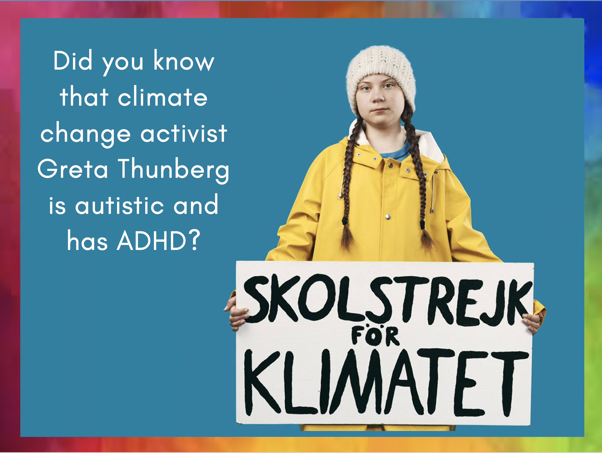

Autism
“A lot of people with autism have a special interest that they can sit and do for an eternity without getting bored…
It’s a very useful thing sometimes…
it can be something you can use for good. And I think that I’m doing that now.”
Often great at remembering things, solving problems,
knowing lots and
being honest
May have a different way of communicating and understanding the world. May be sensitive to noise, bright lights and smells
Greta Thunberg, Climate Activist

Slide 10
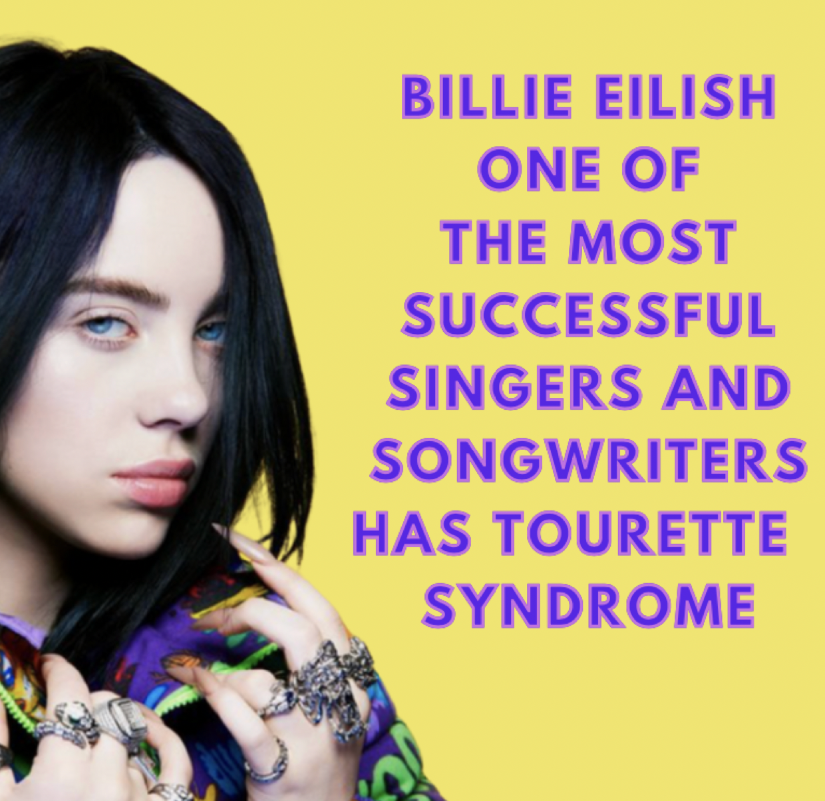
Tourette’s Syndrome
Often great at being empathetic, creative and achieving a lot.
Can make sudden, repeated movements and sounds called “tics”

Slide 11
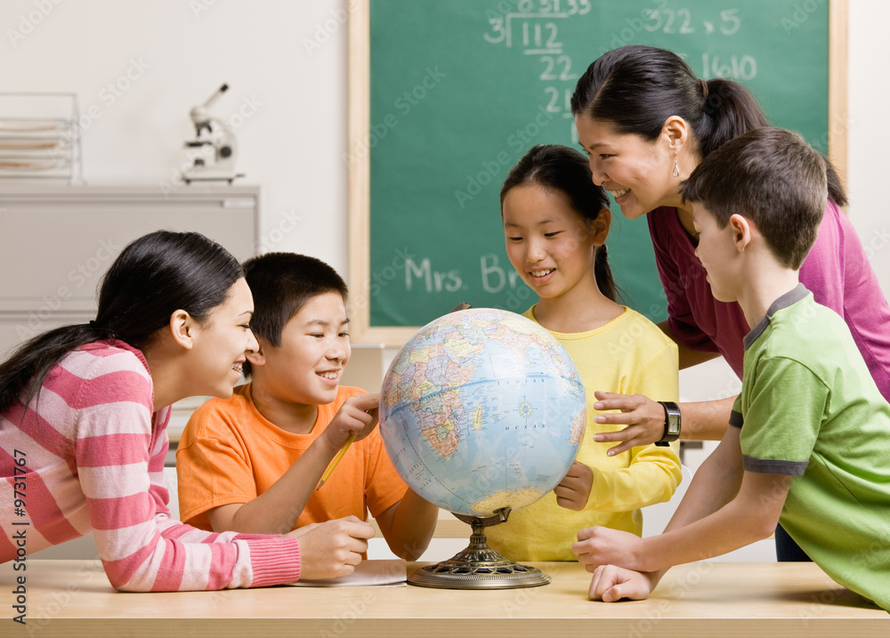
Recognising and Celebrating Strengths and Talents
Neurodiversity Celebration Week reminds us that whatever our differences and challenges, everyone also has their own talents.
Many people who have ADHD, autism, dyslexia, dyspraxia or Tourette Syndrome and experienced challenges in school, are now very successful.
Many say their success is because of their unique way of thinking.

Slide 12
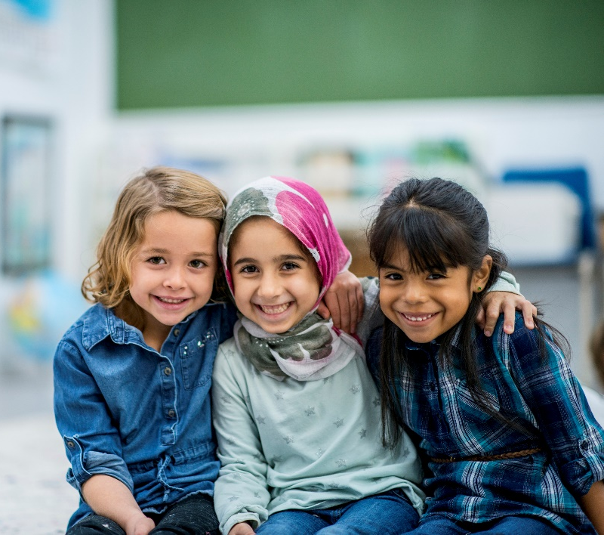
What Can You Do To Help?
Don’t tease or make fun of anyone in your class who is different or who is finding something difficult.
Instead, be kind, understanding and encouraging.
Never forget that you have the power to make a positive difference to someone who may be having a difficult time.
Make someone’s day by being understanding and kind.
It is fantastic that people think in different ways – it makes life more interesting!

Slide 13
March 16 – 20, 2026
www.neurodiversityweek.com

